Slide 1

Investigating stellar structure through orbital decay
Lawrence Berry, UCL
Vincent Van Eylen, Ed Bryant
19/12/2023
[1]
Notes:
Hi everyone,
Introduce myself
- Part-time masters student in Astro at UCL
- Working with Vincent at MSSL
- Halfway through my two years
My thesis is on using transit timing variations to detect orbital decay, and then relating orbital decay to stellar structure theory
I’m going to briefly describe the general idea, and the I’ll give an overview of some of my initial, early results
This is a cartoon of Wasp-12b, a planet that has been confirmed to be decaying into its host star.

Slide 2
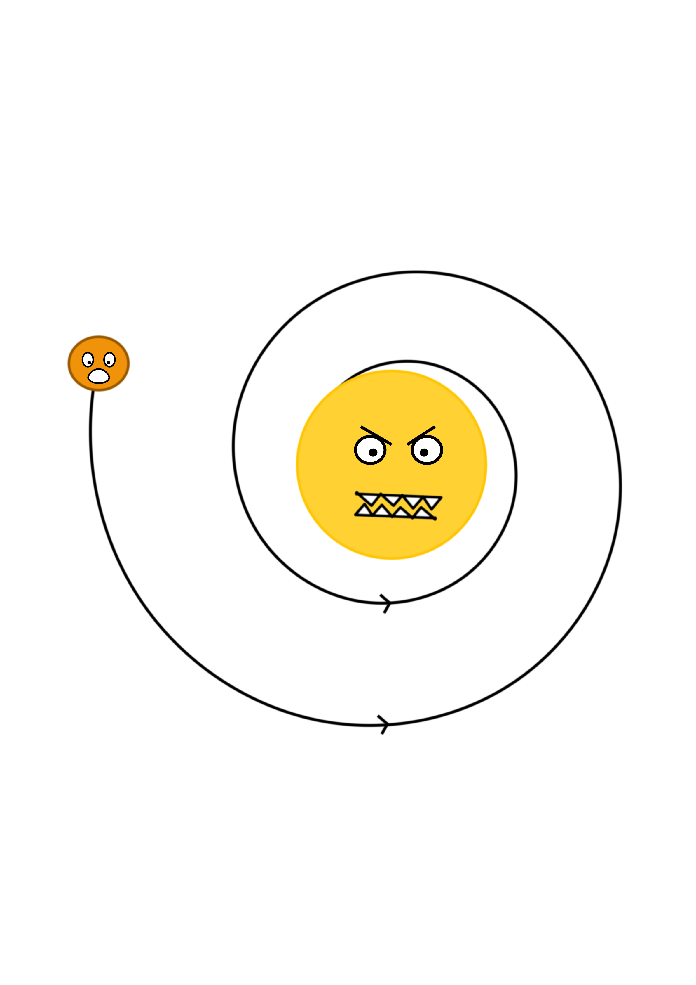
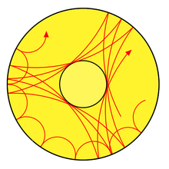
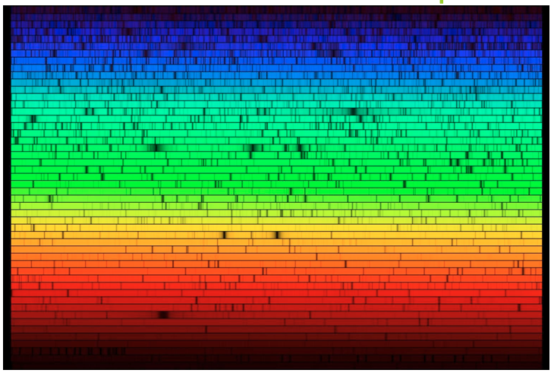
Stellar and planetary composition and structure
Tools for stellar structure:
Planetary structure?
[2]
[3]
[4]
Asteroseismology
Stellar spectra
Tidal decay
Notes:
Why do we care about stellar and planetary structure? It’s interesting and important for understanding the evolution of stars and planetary formation.
Unfortunately we have limited tools with which to study stellar structure, and even more limited tools with which to study internal planetary structure.
We can study oscillations in the brightness of stars over time using asteroseismology, or we can use the frequency dependency of that brightness.
We obviously have telescopes like James Webb for atmospheres, but we can’t use that to glean what’s under the surface.
So adding to that toolset would be a great new way to test and inform stellar and planetary structure models.
One new tool to do so is tidal decay.
Here’s our friendly star WASP-12 again, gobbling up WASP-12b, a hot Jupiter that orbits very close to it.

Slide 3
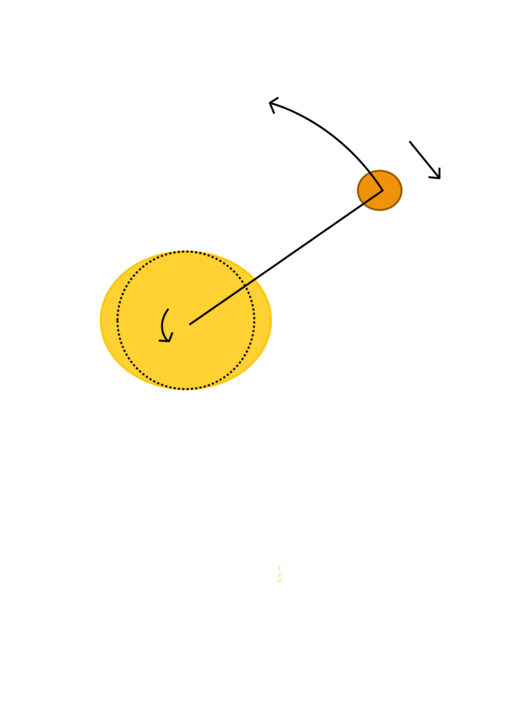
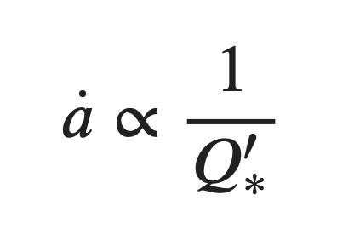
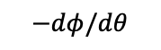
What is tidal decay?
[5]
A planet exerts a gravitational force on its host star creating a tidal bulge
The tidal bulge creates a non-Keplerian potential
If the planet orbits faster than the star spins, it experiences a decelerating torque
$$−dφ/dθ$$
Planet
Star
Stellar tidal dissipation factor
Depends on rigidity and elastic modulus of the star
Tidal decay is a consequence of stellar (and planetary) composition and structure. Decay rates could tell you something about what the star and planet are made of!
Notes:
What is tidal decay?
Run through bullet points with reference to the diagram.
A bunch of work by people like Goldreich, originating with the study of tidal effects in our solar system, like the Earth-Moon, or Jupiter-Io, gave rise to an equation of tidal decay.
The interesting part of that equation involves the stellar tidal dissipation factor.
This is a term which encapsulates how much the star bulges when under the gravitational influence of a planet and also how much that bulge will lag behind the orbit of the planet.
This depends directly on internal properties of the star like its rigidity and elastic modulus.
If eccentricity is close to zero and planetary tidal effects are negligible, which is usually the case, a dot, the rate of decay in metres per second, is inversely proportional to the stellar tidal dissipation.
So measuring decay rates can tell you something about the internal structure of the star.
This particularly affects hot Jupiters. Big Jupiter sized gas giants, since they orbit close to their host star.
The most famous example, and the only one confirmed to be decaying, is WASP-12b.

Slide 4
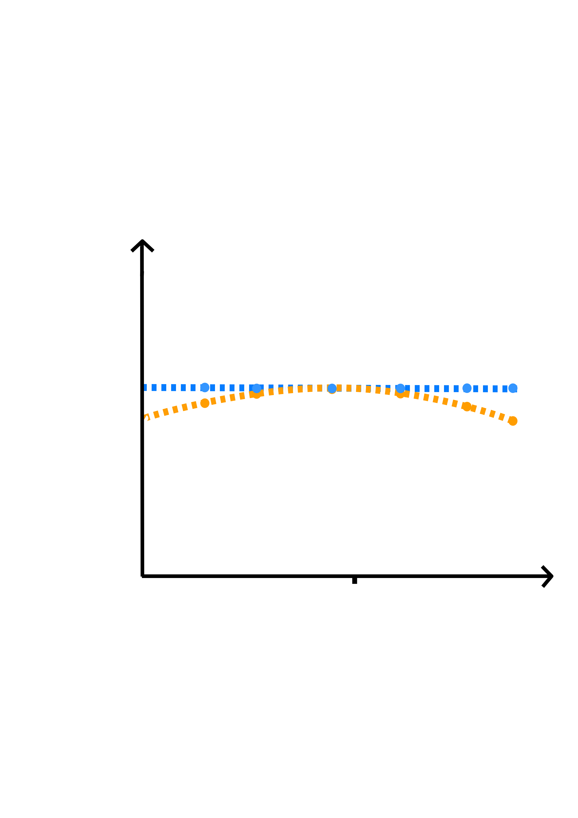
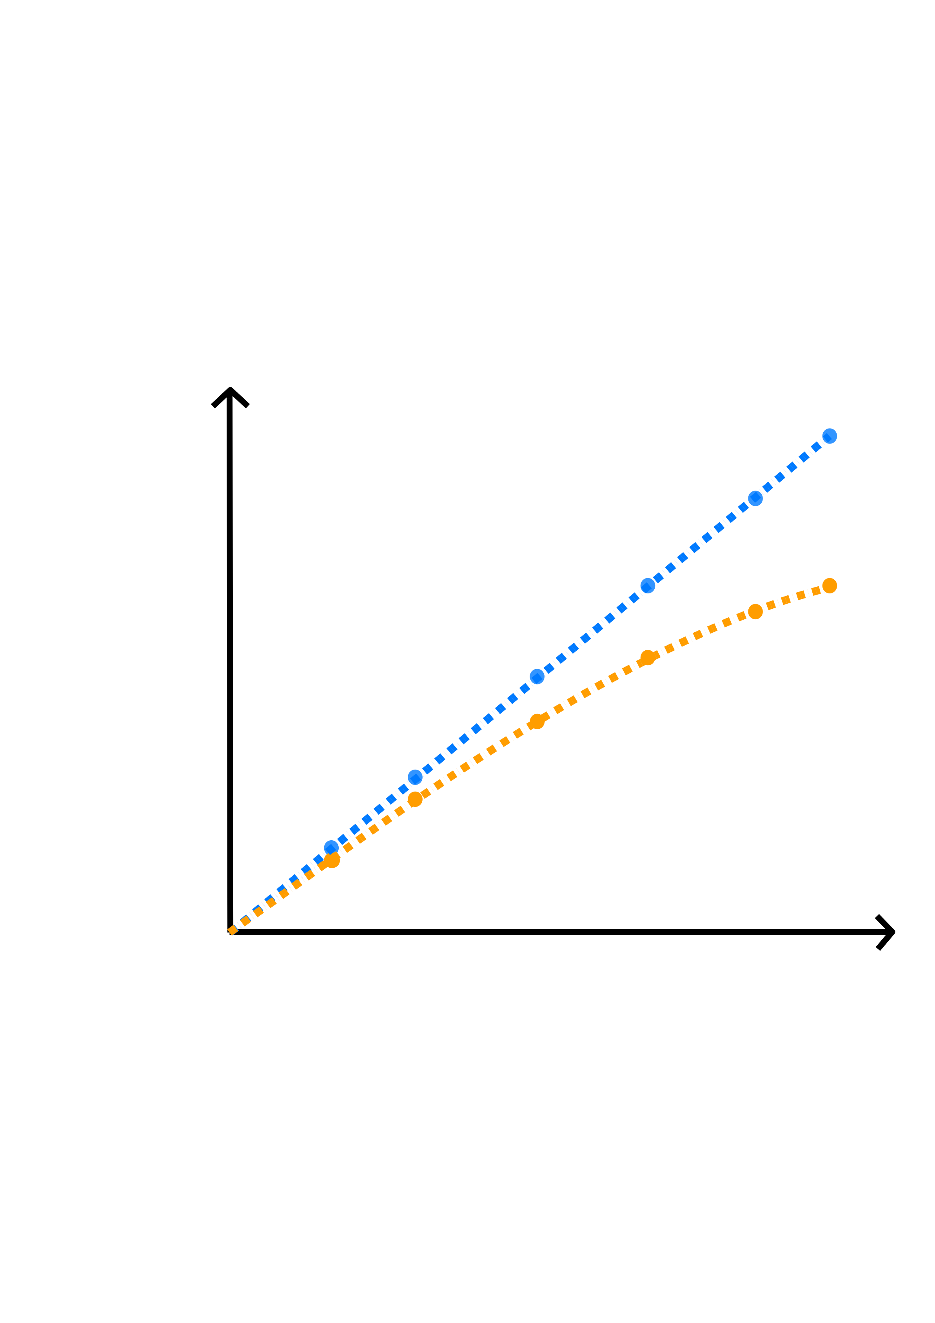
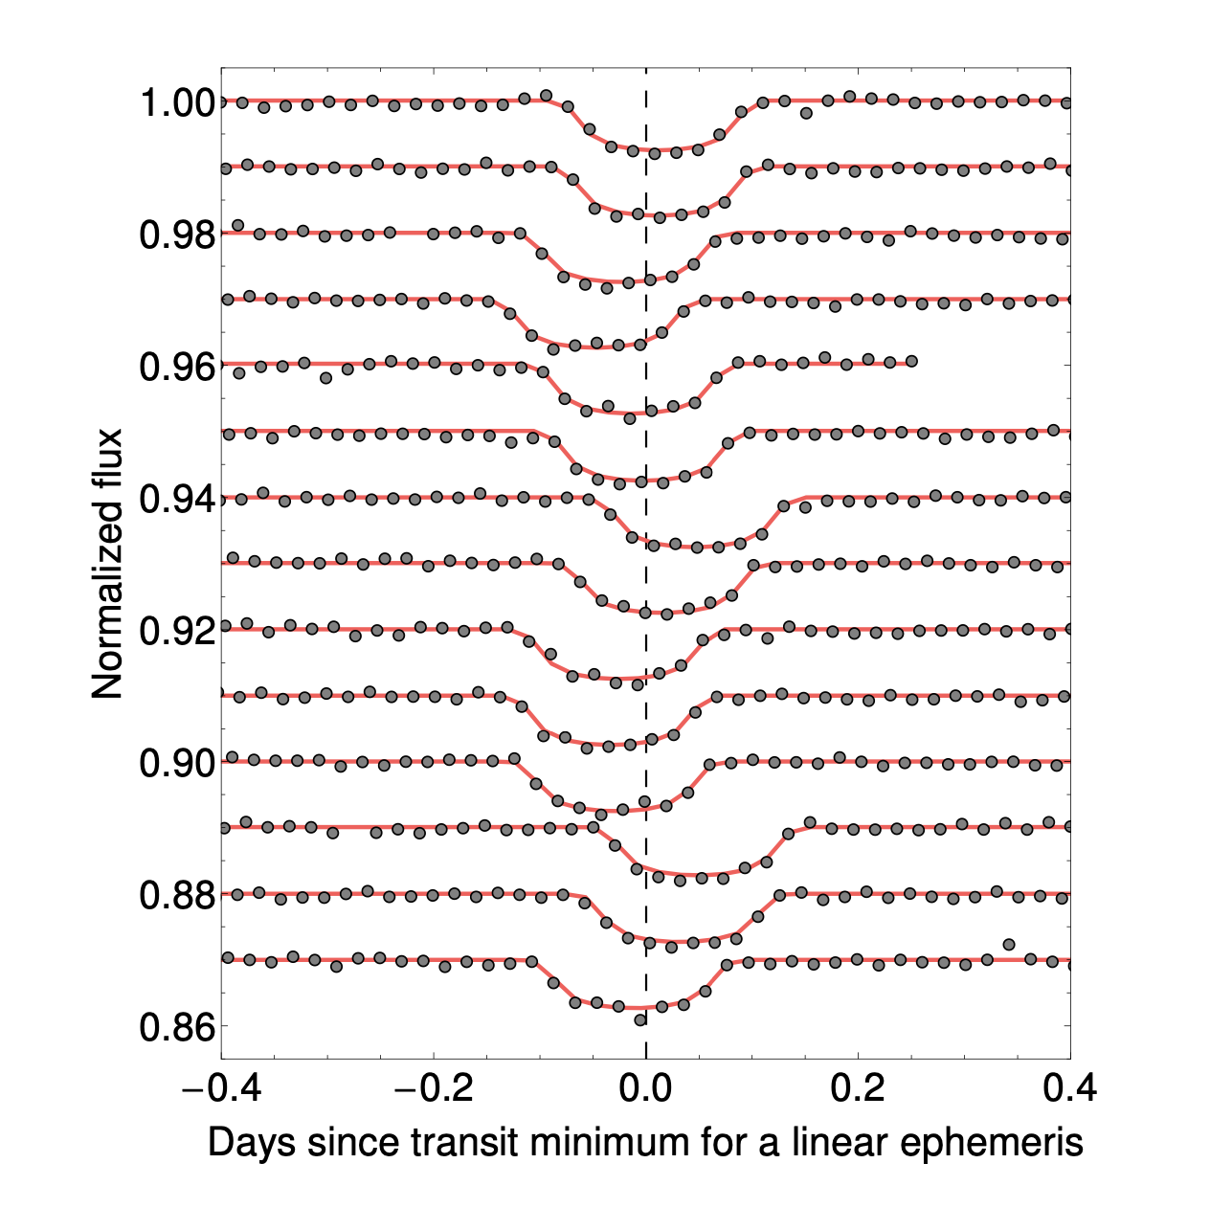
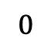
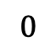
How do we measure tidal decay?
Overlayed light curves of KOI-872
Indirectly via orbital distributions
Or: transit timing variations aka TTVs
Transit time
TTV
No decay
TTV
Decay
No decay
Decay
$$0$$
$$0$$
Epoch
[6]
[7]
Notes:
Some people have inferred constraints on tidal decay by looking at orbital distributions.
Things like:
How the age of planets is distributed relative to distance from their host star.
Or observed eccentricities or spin–orbit misalignment.
But this is indirect evidence.
More directly, we can use transit timing variations aka TTVs.
What are TTVs? Deviations of the midpoint transit time from what you would expect if this planet were orbiting in a perfect closed ellipse.
In the case of tidal decay, we observe that each transits happen ever so slightly sooner than we might otherwise expect under the assumption of a constant period.
Typically the deviations are very small so they’d be indistinguishable on a plot of transit time vs epoch, so instead we plot the TTV directly like this.
Another way of looking at this is stacking all the light curves on top of each other, phase folded by some constant period.
You can see in this example that the mid times don’t line up super well. In this case the deviations are kind of random rather than systematic, so it’s unlikely to be decay, and more likely to be a form of precession or just noise.

Slide 5
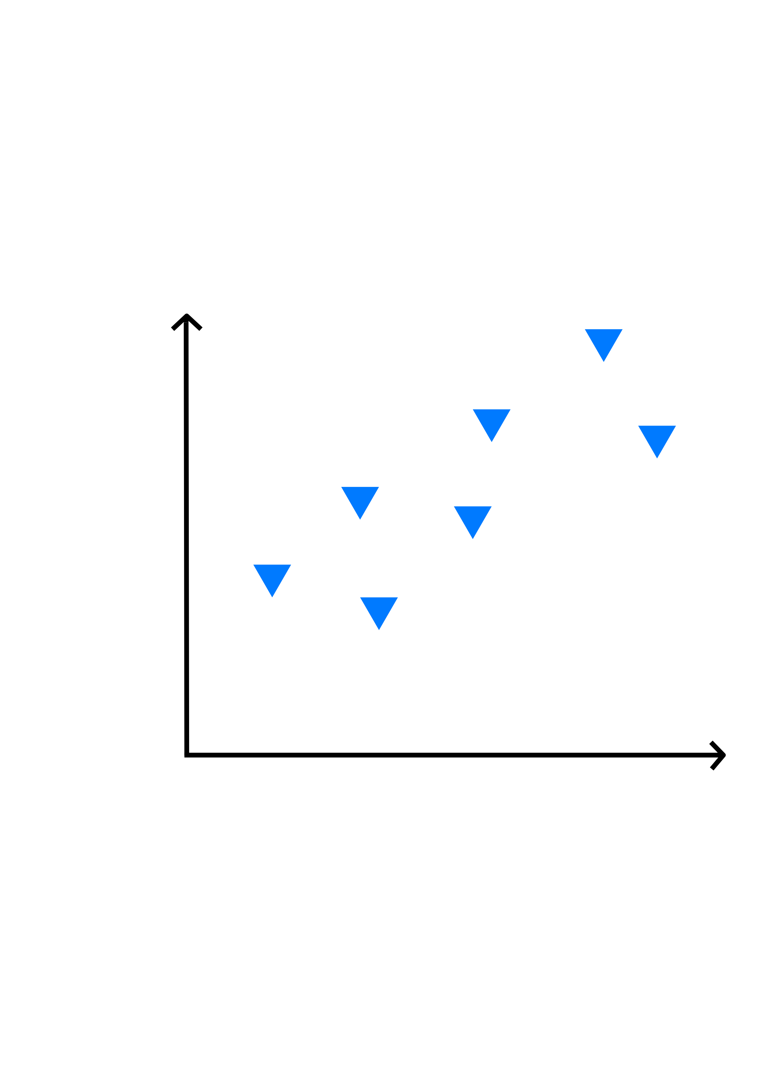
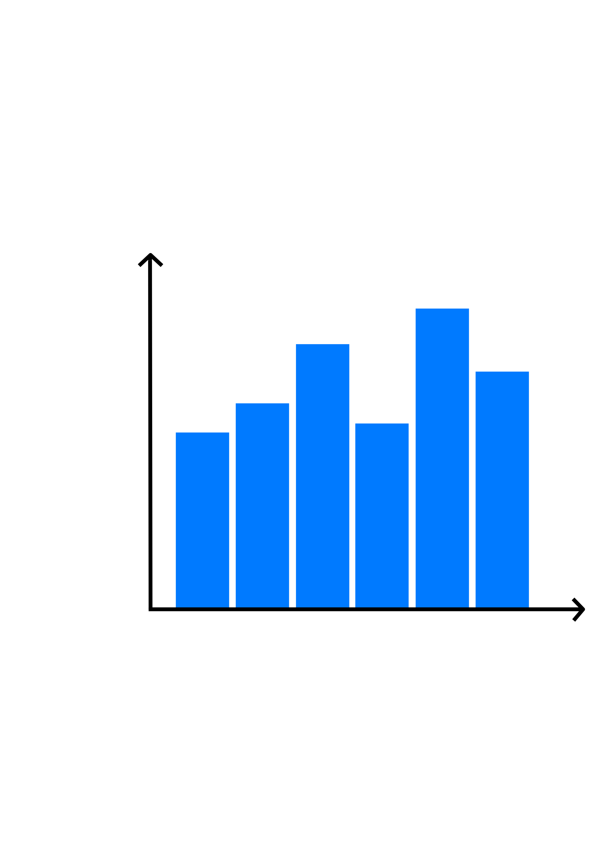
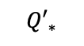
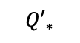
Aims of my project
Let’s model all systems for which we have transit observations
Build an empirical distribution of stellar tidal dissipation factors
Test stellar structure theory by analysing how other stellar properties relate to the tidal dissipation factors we observe
Transit time
Freq.
$${Q′}_{∗}$$
Epoch
$${Q′}_{∗}$$
Stellar properties
[8]
Notes:
Main idea: people have studied orbital distributions, they’ve looked into orbital decay of example planets, but what can we understand by analysing a full sample of planets rather than just individual planets?
Run through the bullet points.

Slide 6


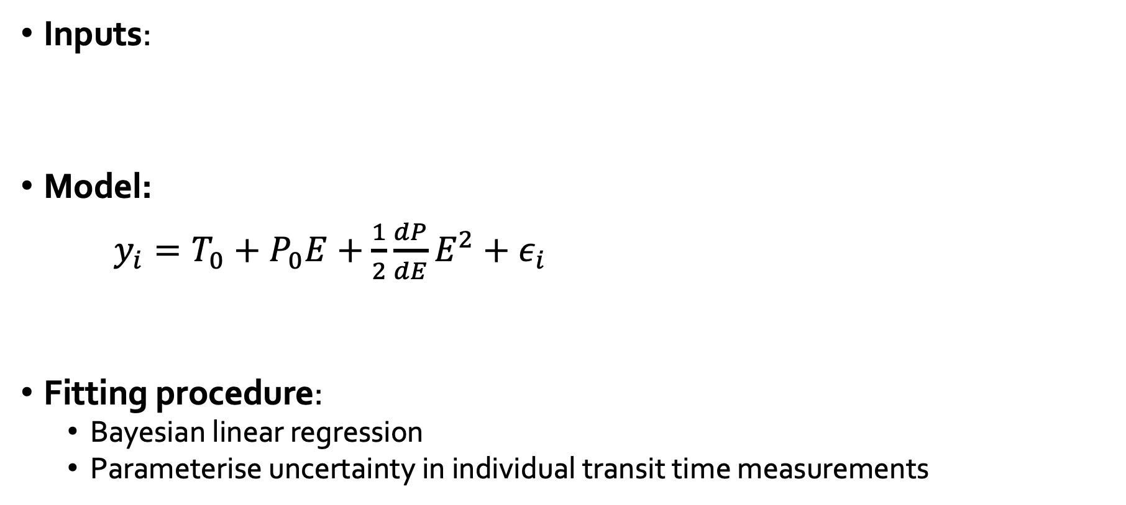
Method
Inputs:
Model:
$y_{i}=T_{0}+P_{0}E+\frac{1}{2}\frac{dP}{dE}E^{2}+ε_{i}$
Fitting procedure:
Bayesian linear regression
Parameterise uncertainty in individual transit time measurements
[9]
[10]
[11]
Measured transit time
Reference time
Constant period component
Decay rate per orbit
Measurement noise
Notes:
Inputs
Pre-fitted exoplanet transit light-curve mid times
More transit mid-times are available than actual light curves
MCMC is slow and I have a dual-core laptop
From a variety of professional + citizen-scientist sources
ExoClock
Exoplanet Transit Database
Transit timing en-masse (homogenous light curve fitting of TESS data, from Ivshina & Winn)
Model
Observed transit time is going to be a function of the reference time, a constant period component and a decay rate component, with some added Gaussian noise representing measurement error.
Where E stands for epoch, the number of orbits.
This is the standard way of modelling this problem in the literature, and it’s roughly the relationship that tidal decay theory predicts as well.
Fitting procedure
Bayesian linear regression
i.e. ordinary linear regression but accounting for uncertainties
Preferable to MCMC: speed, convergence, model evidence, high dimensionality
Parameterise uncertainty in individual transit time measurements
Helps account for inaccurate estimations of transit time error
Like a softer form of outlier detection: de-weight instead of discard

Slide 7
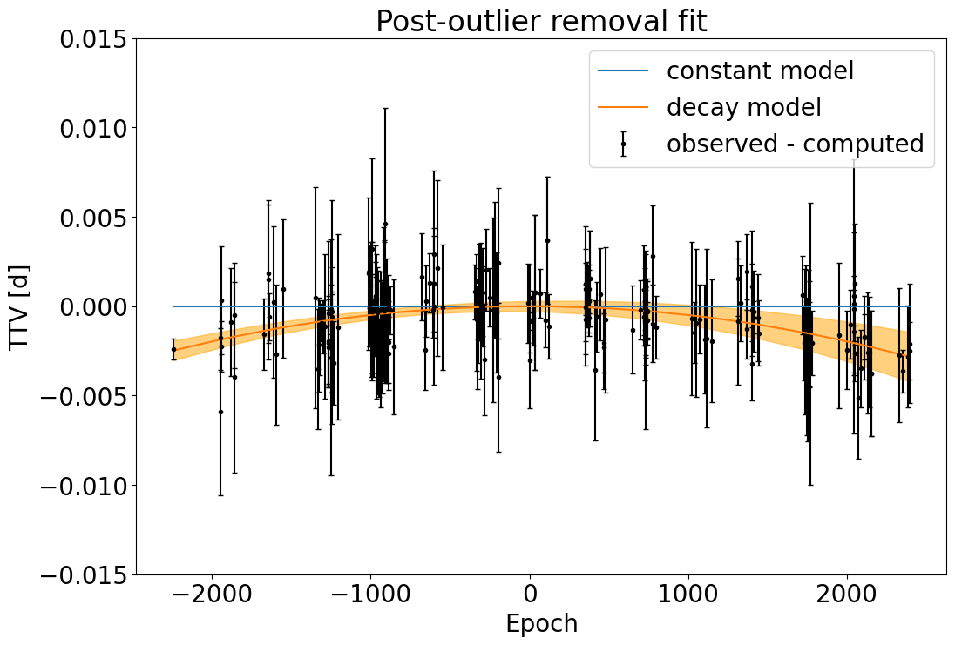
Example: WASP-12b
3σ posterior model error
A curve fits better than a straight line!
[12]
Notes:
Here’s an example of that method at work.
We have around 200 or so transit times of Wasp-12b, and like the cartoon plot earlier we’re plotting transit time variation (deviation from a constant period) vs epoch, the number of orbits.
We see pretty clearly, to 3 standard deviation error, that a curve fits better than a straight line, i.e. this planet is decaying.

Slide 8
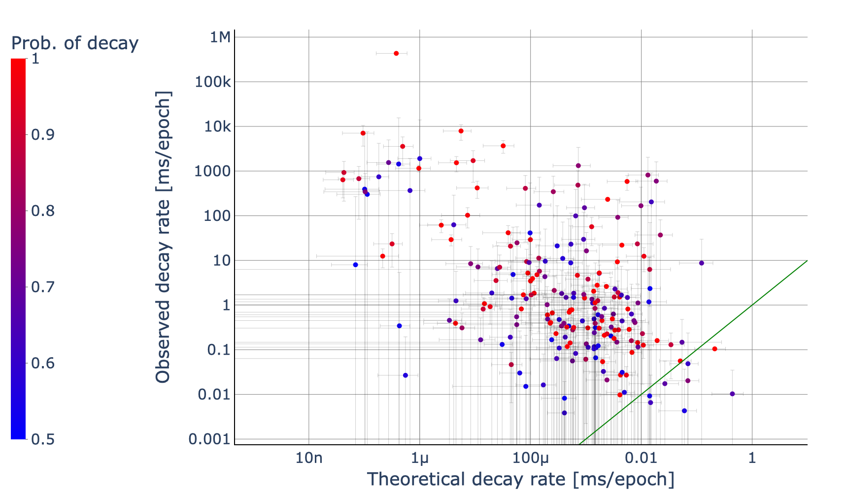
Observations vs theory (442 planets)
Observation ≠ theory: perhaps something else is going on?
[13]
WASP-19
Observation ≃ theory
Good candidates for tidal decay
WASP-18
WASP-4
TRES-3
WASP-12
Notes:
So, what do we get if we run this fitting process for 442 known planets?
On the y axis we have the observed decay rate that we’ve found by fitting to the transit times, and on the x axis we have the decay predicted by tidal decay theory, which is calculated assuming those planets orbit solar-like stars.
This green line is the y=x line where theory is in agreement with observations.
Each dot is a planet and the colour corresponds to how statistically significant the observed decay is. The red ones are essentially very high likelihood of decay, whilst the blues ones show no statistically significant decay measurement.
First things first, among the red “high likelihood of decay” planets we see some familiar names. These are planets that have already been highlighted in the literature as possible candidates for decay. Our analysis suggests these are indeed decaying, and their decay agrees roughly with that predicted by tidal decay theory.
Wasp-12, our familiarly unfriendly star-planet system, has strong evidence for decay and our observation agrees pretty bang on with the theory.
Second, I’d like to point out that this area around the green line where tidal theory and observations agree are good candidates for follow up study of tidal decay.
But what about this lot? It looks like there are a lot of planets that appear to be decaying faster than what tidal theory would suggest. What’s going on?
Well, a few things come into play. The theory calculation assumes the planets are orbiting solar-like stars, that may not be the case. There could be other physical phenomena at play causing TTVs. Some of these at the top left are multi-planet systems, and the influence of companion planets can cause precession which could accidentally be picked up as a decay.
It could also just be noisy data. Some of these error bars as you can see are huge. With more observations those will hopefully improve.

Slide 9
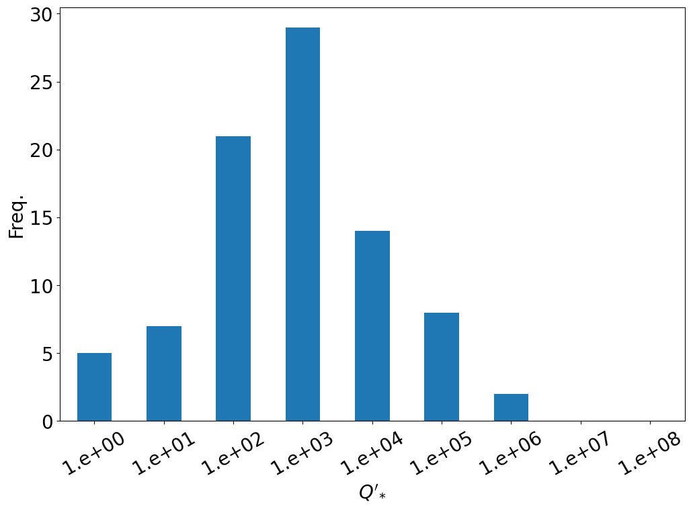
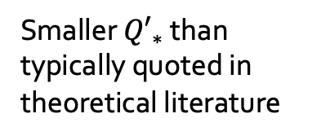
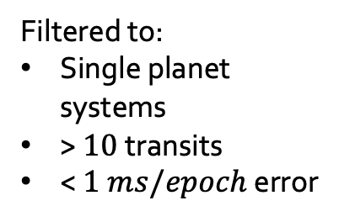
Empirical distribution of ${Q′}_{∗}$
Literature > 10⁵ (e.g. Ogilvie, 2014)
Filtered to:
Single planet systems
> $10$transits
< $1 ms/epoch$ error
[14]
Smaller ${Q′}_{∗}$ than typically quoted in theoretical literature
WASP-12 falls in the 10⁵ bucket
Notes:
Very preliminary results!
Let’s remove some troublesome datapoints at the extremes for the rest of the analysis
Multi-planet systems
Planets with few transits
From numerical simulations of tidal mechanisms by Professor Gordon Ogilvie Q’* is typically placed around or greater than 10^5, so it is surprising that we see so many star-planet systems lower than this.
i.e. they appear to be decaying more than they should.
Interestingly though the well-studied planets like WASP-12b agree with literature values.
Maybe it’s noise, maybe my assumptions are wrong, or maybe something more interesting is going on?

Slide 10
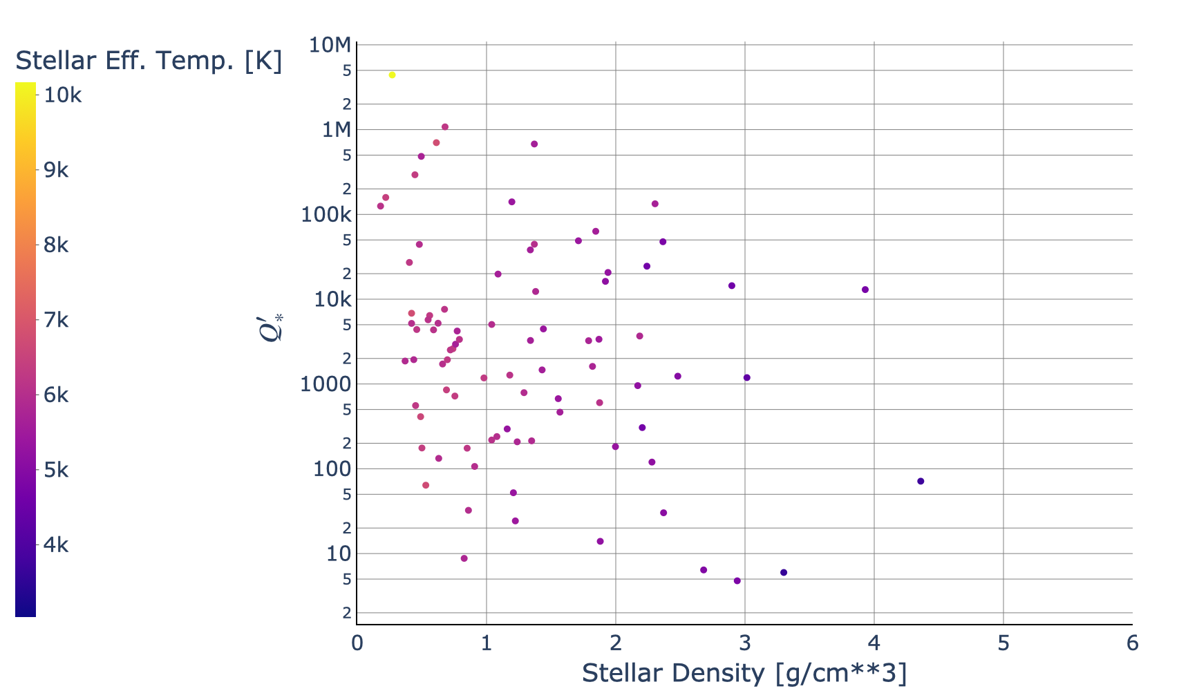
How does ${Q′}_{∗}$ relate to stellar properties?
[15]
Notes:
Now for what we really want: how does Q* vary with stellar properties like density, effective temperature and age?
Let’s plot stellar density of the x axis and tidal dissipation factor on the y axis.
Empirically it appears that denser stars tend to have lower tidal dissipation factors
And hotter stars tend to have higher tidal dissipation factors
Why is this interesting, well now we can start to connect back the decay rates we observe with stellar structure theory.
The mechanisms of tidal dissipation are quite complex, but being able to plot these relationships is really the start of understanding them.
If asked:
Any mechanism that provides a frictional or viscous drag on the equilibrium tide will lead to a lag in the tidal bulge and a tidal torque.
In stars, where the viscosity of the fluid is usually negligible, the main candidate is an effective “eddy viscosity” resulting from turbulent motion. This could be due to convective motion in regions such as the outer part of the Sun, where the star’s luminosity is being carried to the surface predominantly by convection.
What drives these convective zones is kind of tricky. It depends on its mass and on its evolutionary phase. And convective zones switch from an envelope for solar like stars to having convective cores at really high masses.
More massive stars, typically less dense, typically have larger convective zones so maybe more tidal dissipation resulting from friction going on?
The way they get their cores hot enough to fuse hydrogen is via gravitational contraction, but a more massive star does not need to contract as much to reach the necessary temperature. Since it does not need to contract as much, it is at lower density.

Slide 11
Future work
Are these relationships real? Are our assumptions okay?
Other physical phenomena might be at play
e.g. we might accidentally be catching sinusoidal TTVs due to precession
Is decay rate constant per epoch?
Are mid transit times unbiased and Gaussian?
Once we gain confidence in the results, let’s connect these observations with stellar structure theory
These techniques can also help inform which planets we should observe in future
Notes:
Some assumptions we made to simplify the problem:
We assume that any TTV we observe is the result of stellar tidal dissipation (i.e. tides raised by a planet on its star) causing orbital decay. We ignore all precessional or other effects.
Decay rates are constant per epoch
Fitted transit mid times are unbiased and distributed with Gaussian error
Once we gain confidence in the results, let’s connect the observations with stellar structure theory to figure out why these observed relationships between stellar density and tidal dissipation factor exist.
These techniques can also inform which planets we should observe next, since we get out a concrete formula of how decay rate uncertainty changes with the number of precision of transit time measurements.

Slide 12
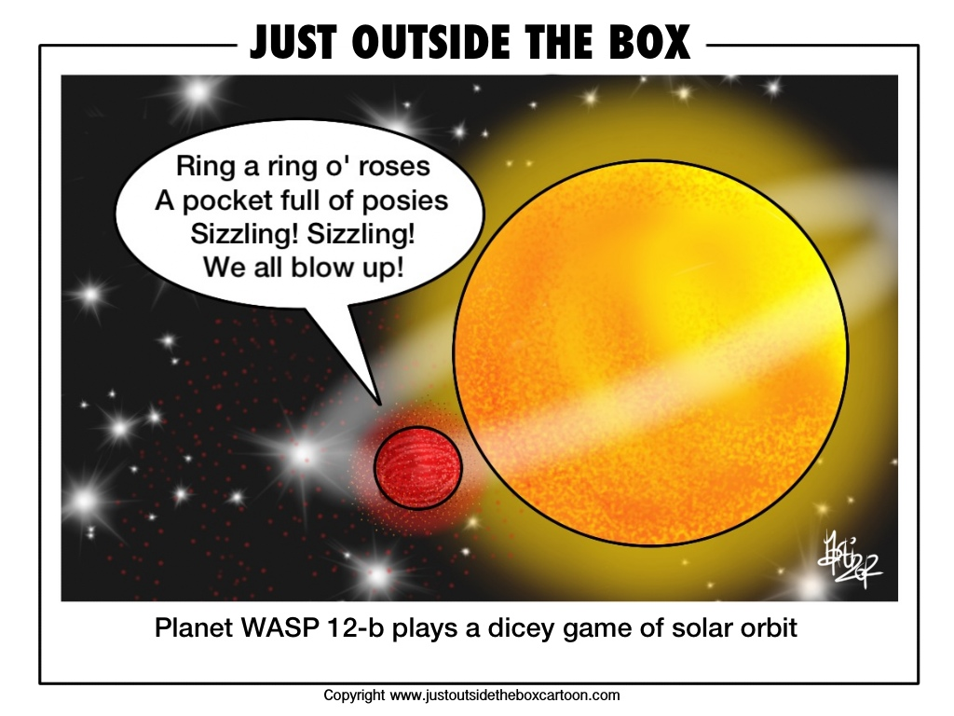
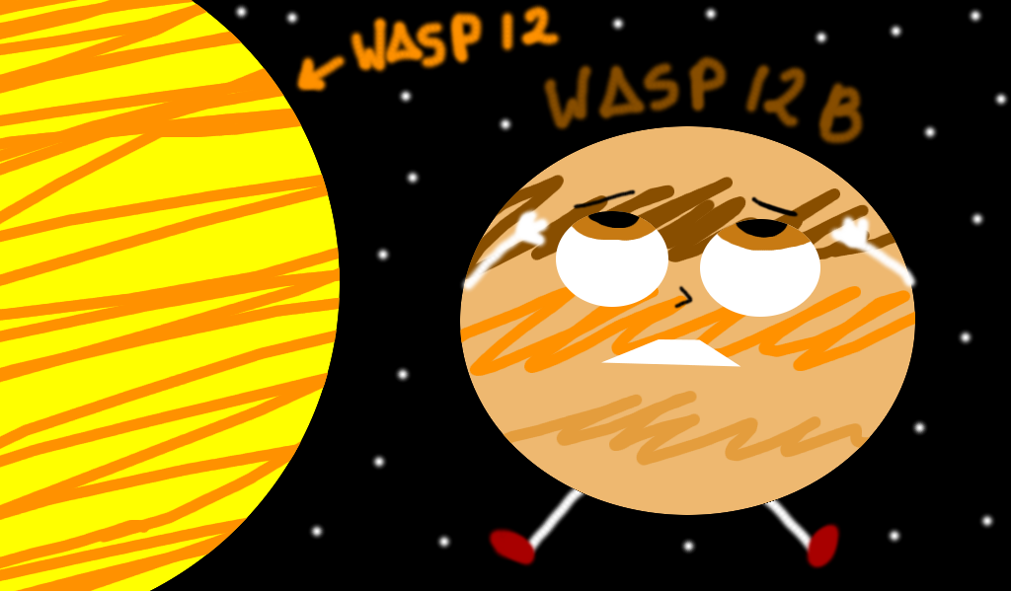

Summary
Measuring tidal decay for a large ensemble of stars provides new opportunities for studying stellar structure
Initial results suggest a relationship exists between stellar density/ temperature and the size and lag of a star’s tidal bulge
Understanding these relationships better could help determine the structure of stars!
[16]
[17]
[18]
Notes:
So to summarise
Run through bullet points
And I’ll leave you with some fun comics of Wasp-12b plunging to its untimely death.

Slide 13
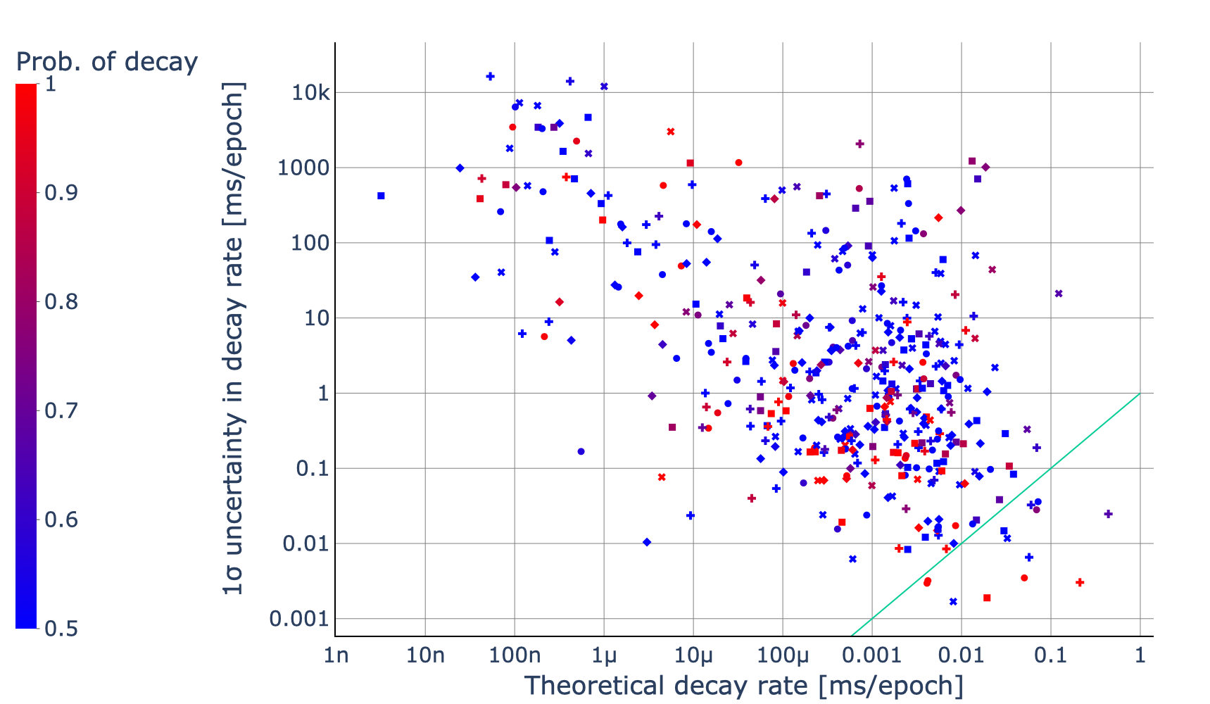
Appendix A: which planets should we follow up on?
Uncertainty > theory: these planets need further observing
[19]
TRES-3,
WASP-4,
WASP-12,
WASP-18,
WASP-19
13
Notes:
My assertion is that we want to investigate those systems that have high theoretical decay.
Those with low observed variance are hopefully confirmed to be decaying or not to some level of statistical significance, or can be confirmed with some further measurement to bring down the observed variance.

Slide 14
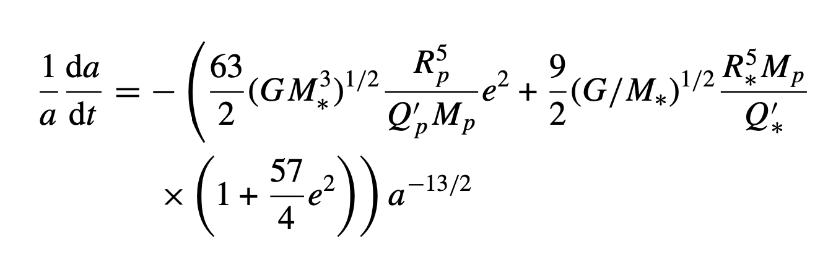
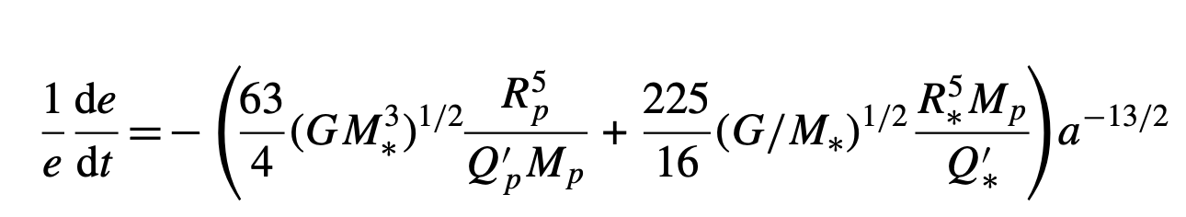
Appendix B: tidal decay equations
[Goldreich 1963, Jackson 2009]

Slide 15
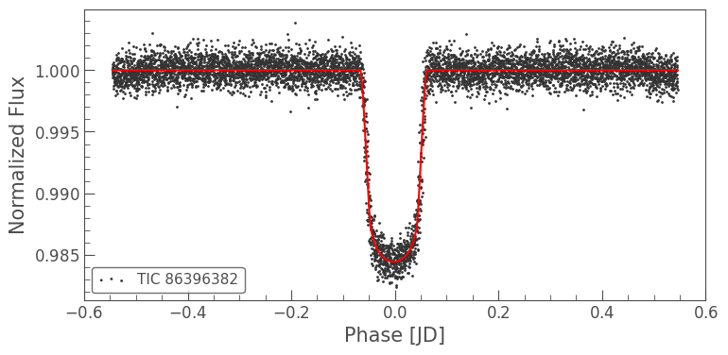
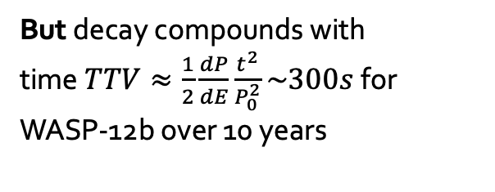
Appendix C: why is this a hard problem?
Uncertainty in the transit time measurements is large
Fundamental lower limit ~ sampling rate
Noisy citizen-science data
Inhomogeneous sources
Different physical phenomena at play
Often of the same order as the timing variation we’re trying to measure
[20]
We’re talking about things that vary milliseconds per epoch and this scale is in days!
But decay compounds with time$TTV≈\frac{1}{2}\frac{dP}{dE}\frac{t^{2}}{P_{0}^{2}}\sim 300s$ for WASP-12b over 10 years
Notes:
This is not an easy problem
Fundamental limit due to sampling rate lower limit: most Tess cadences are 2 minutes, I think some 20s going forward and full frame images every 30 minutes.
Large experimental error, especially from citizen-scientist data, but they are crucial to provide longer baseline time ranges of transit observations.
Data comes from lots of inhomogenous sources, just the other week there was a paper about how you shouldn’t rely on inhomogenously fitted transit times, but should rather model light curves directly in a consistent manner if you want to fit decays.
Not all TTV is the result of tidal dissipation with respect to the star. Other gravitational perturbations can have TTV effects too, including precessional effects like:
Quadrupole field as a result of rotational flattening
Tidal precessional effects (Raggozine and Wolf 2009)
Companion planets creating non-spherical potentials
General relativistic effects
Fitting lots of light curves is slow and getting access to many light curves can be hard
Let’s work off existing fitted transit times
In fact, because decay per epoch compounds over time. Theory suggests that decay is roughly constant per orbit. As the planet decays it undergoes more orbits per year, so the decay per time goes up.
After 10 years we’re talking about a total transit time variation of more like 300s for WASP-12b.

Slide 16
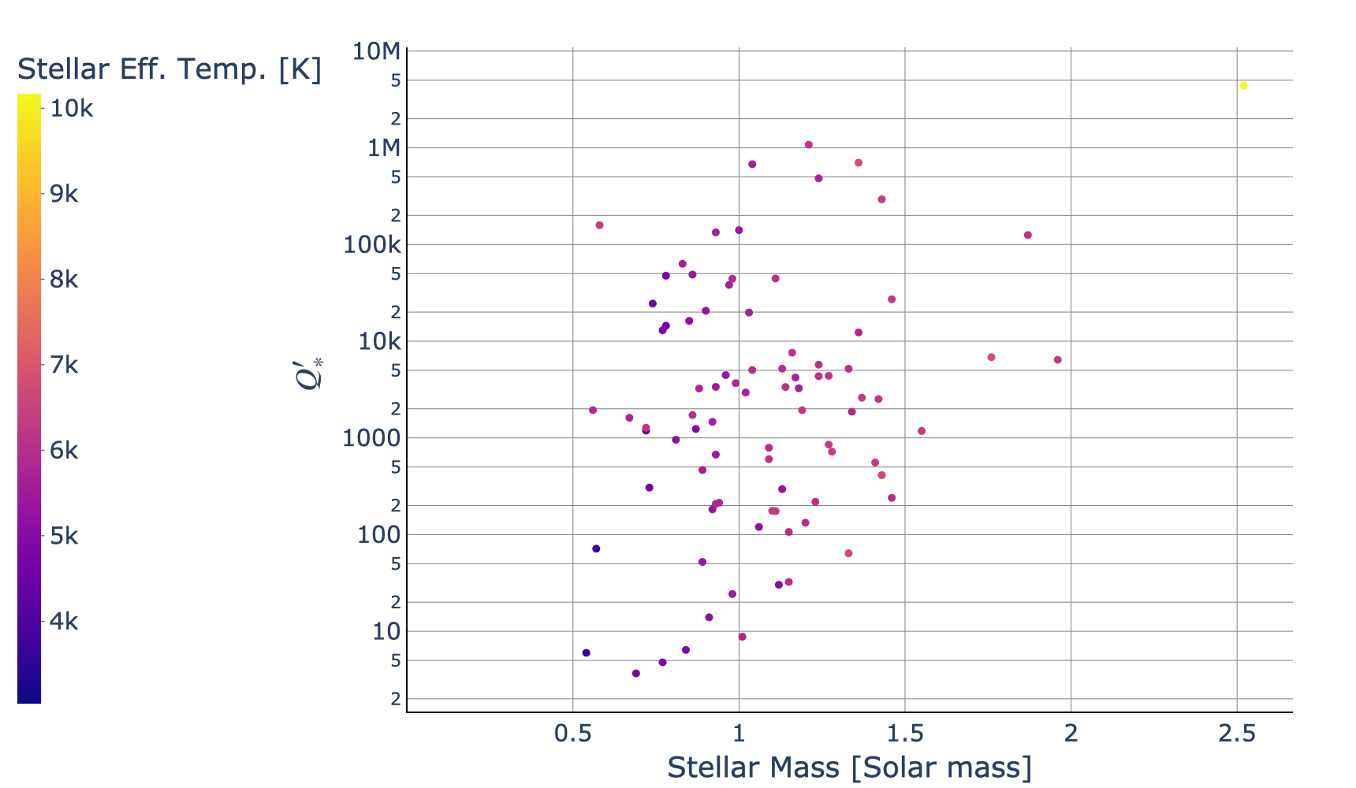
Appendix D: ${Q′}_{∗}$ vs stellar mass
[21]

